Slide 1
Scientific Computing with Python (SciPy)

Slide 2
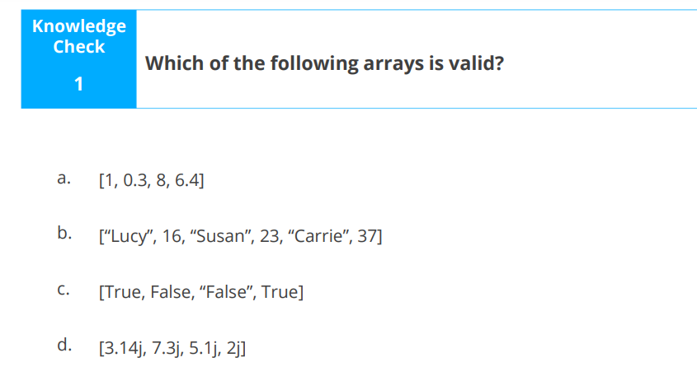
RECAP OF PREVIOUS LESSON

Slide 3
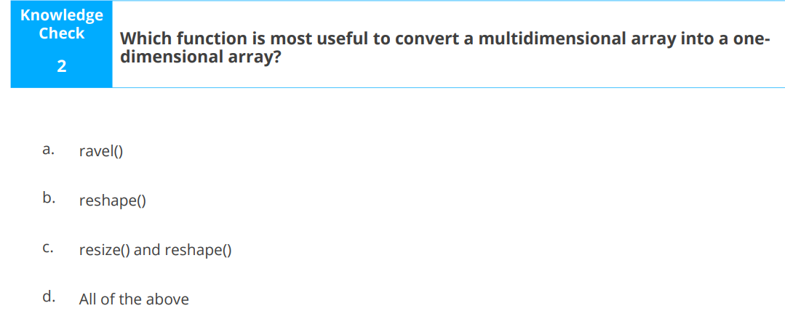

Slide 4
LEARNING OBJECTIVES
By the end of this lesson, you will be able to :
Explain the importance of SciPy
List the characteristics of SciPy
Explain sub-packages of SciPy
Discuss SciPy sub-packages, such as optimization, integration, linear algebra, statistics, weave, and IO

Slide 5
SciPy is a scientific computation library that uses NumPy underneath.
SciPy has optimized and added functions that are frequently used in NumPy and Data Science.
As SciPy is more focused on scientific implementations, it provides many built-in scientific constants.
constants can be helpful when you are working with Data Science.

Slide 6
Inverse matrices are frequently used to encrypt message codes. Matrices are used by programmers to code or encrypt letters. A message is made up of a series of binary numbers that are solved using coding theory for communication. As a result, the concept of matrices is used to solve such equations.

Slide 7
SciPy and Its Characteristics
Built-in mathematical libraries and functions
Simplifies scientific application development
Large collection of sub-packages for different scientific domains
High-level commands for data manipulation and visualization
Integrates well with multiple systems and environments
Efficient and fast data processing

Slide 8
Packages in Scipy
Some widely used packages are:
Integration
IO
Linear Algebra
Optimize
Statistics
Weave packages

Slide 9
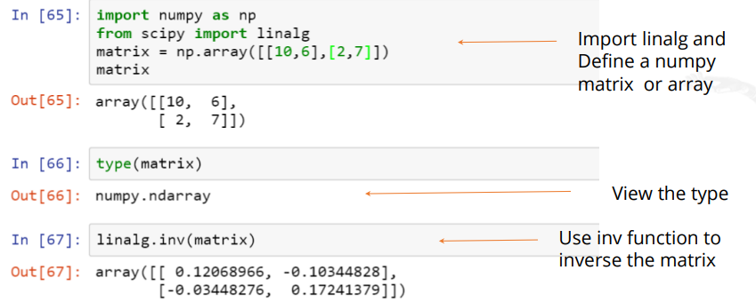
SciPy Sub-Package: Linear Algebra
SciPy provides rapid linear algebra capabilities and contains advanced algebraic functions.
Inverse of a matrix : This function is used to compute the inverse of the given matrix. Let’s look at the inverse matrix operation.

Slide 10
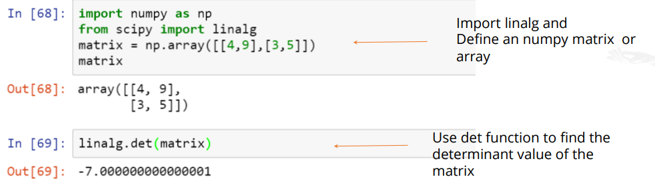
Finding Determinant

Slide 11
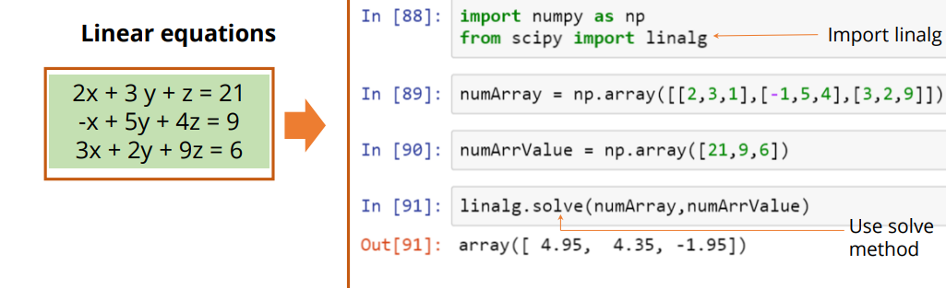
Solving Linear Systems

Slide 12
SciPy Sub-Package: Statistics
This package contains distributions for which random variables are generated.
These packages enable the addition of new routines and distributions. It also offers convenience methods such as pdf(), cdf()
Following are the statistical functions for a set of data:
o linear regression: linregress()
o describing data: describe(), normaltest()

Slide 13
What is a Random Number?
Random number does NOT mean a different number every time. Random means something that can not be predicted logically.
NumPy offers the random module to work with random numbers.
The syntax varies for integers and float
To generate just a random integer from an array of 0 to 100, the syntax is:
np.random.randint(100). To generate five random integer, it changes to np.random.randint(100, size = (5)).
To generate a float from an array of 0 to 1, the syntax is:
np.random.rand(). To generate five random floats, it changes to np.random.rand(5)

Slide 14
Some Common Terms
Normal Distribution(A.K.A the Gaussian Distribution): This is one of the most important distributions because it fits the probability distribution of many events e;g IQ Scores, Heartbeat etc.
It has three parameters:
loc – (Mean) where the peak of the bell exist
scale – (Standard Deviation) how flat the graph distribution should be
size – The shape of the returned array
Probability Density Function : This is a function that describes a continuous probability i.e probability of all values in an array
Cumulative Distribution Function : This describes the probability that a random variable, X with a given probability distribution will be found at a value less than or equal to x.

Slide 15
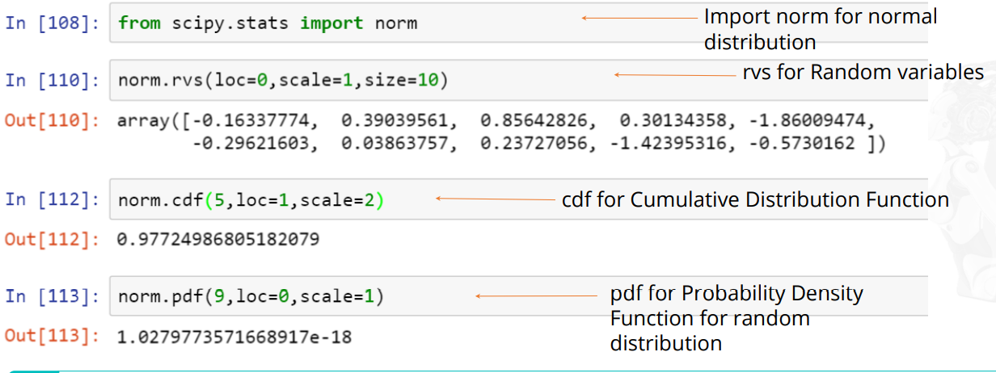

Slide 16
SciPy Sub-Package: Weave
The weave package provides ways to modify and extend any supported extension libraries.
Features of Weave Package:
Includes C/C++ code within Python code
• Speed ups of 1.5x to 30x compared to algorithms written in pure Python
Two main functions of weave::
• inline() compiles and executes C/C++ code on the fly
• blitz() compiles NumPy Python expressions for fast execution

Slide 17
SciPy Sub-Package: IO
The IO package provides a set of functions to deal with several kinds of file formats.It offers a set of functions to deal with file formats that include:
• MatLab file
• IDL files
• Matrix market files
• Wav sound files
• Arff files
• Netcdf files
Package provides additional files and its corresponding methods such as:
• Numpy.loadtxt()/Numpy.savetxt()
• Numpy.genfromtxt()/Numpy.recfromcsv()
Numpy.save()/Numpy.load()

Slide 18
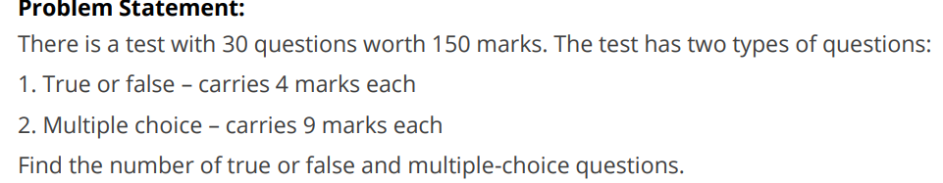

Slide 19
